Slide 1
COMP 301 Analysis of Algorithms
Medians and Order Statistics

Slide 2
Order Statistics
The i^{th} order statistic of a set of n elements is the i^{th} smallest element
Minimum: 1st order statistic
Maximum: n^{th} order statistic
Median:
If n is odd: i = (n+1)/2
If n is even: lower median
upper median

Slide 3
Selection Problem
Better solutions exist:
O(n) expected running time
O(n) worst-case running time

Slide 4
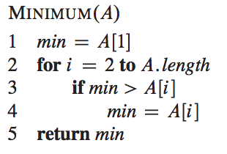
Minimum and Maximum
Minimum can be found using n-1 comparisons

Slide 5

Simultaneous Minimum and Maximum
A graphics program may need to scale a set of (x, y) data to fit onto a rectangular display screen or other graphical output device
The program must first determine the minimum and maximum value of each coordinate
We can find the minimum and maximum using at most comparisons

Slide 6
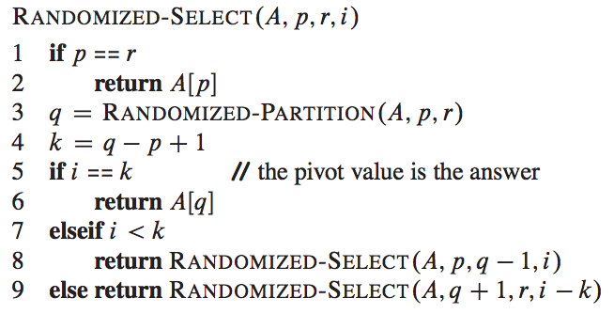
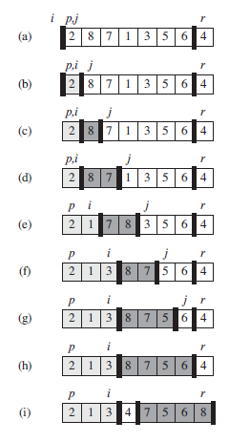
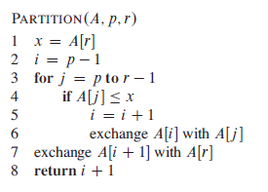

Selection in Expected Linear Time

Slide 7
Selection in Expected Linear Time
Expected running time is linear

Slide 8
Selection in Expected Linear Time
Let the running time on an input array A[p..r] of n elements be a random variable T(n)
Find an upper bound on E[T(n)]
The procedure RANDOMIZED-PARTITION is equally likely to return any element as the pivot
For each k such that 1 <= k <= n, the subarray A[p .. q] has k elements (all less than or equal to the pivot) with probability 1/n

Slide 9

Selection in Expected Linear Time
When we call RANDOMIZED-SELECT and choose A[q] as the pivot element we may
Terminate immediately with the correct answer
Recurse on the subarray A[p..q-1]
Recurse on the subarray A[q+1..r]
This decision depends on where the i^{th} smallest element falls relative to A[q]
Assuming that T(n) is monotonically increasing, we can upper-bound the time needed for the recursive call by the time needed for the recursive call on the largest possible input.

Slide 10
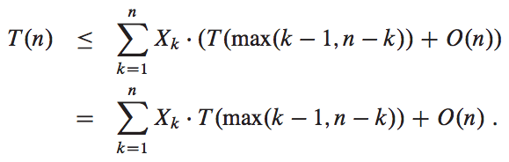
Selection in Expected Linear Time
To obtain an upper bound, we assume that the i^{th} element is always on the side of the partition with the greater number of elements
For a given call of RANDOMIZED-SELECT, the indicator random variable X_{k} has the value 1 for exactly one value of k, and it is 0 for all other k
When X_{k} = 1,the two subarrays on which we might recurse have sizes k-1 and n-k

Slide 11
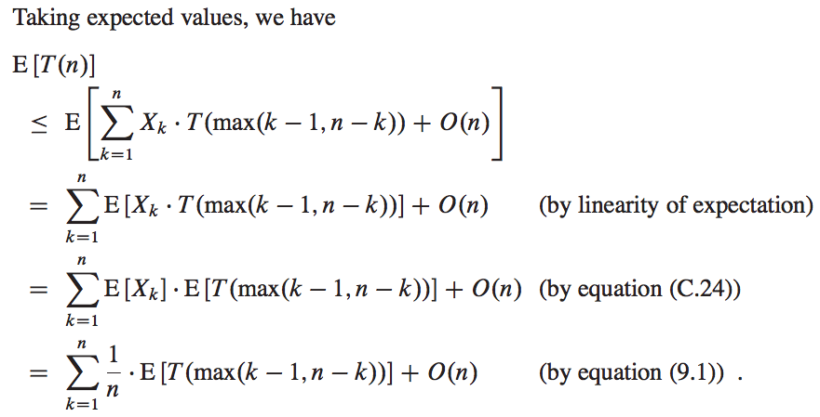
Selection in Expected Linear Time

Slide 12

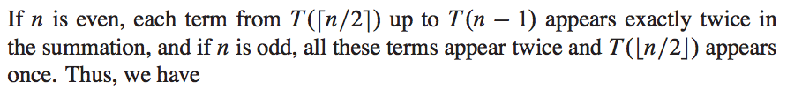

Selection in Expected Linear Time

Slide 13

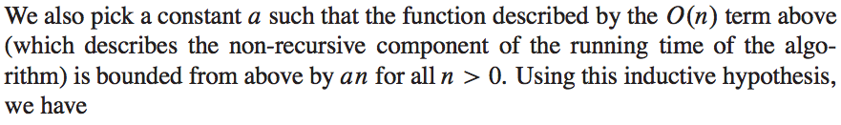
Selection in Expected Linear Time

Slide 14
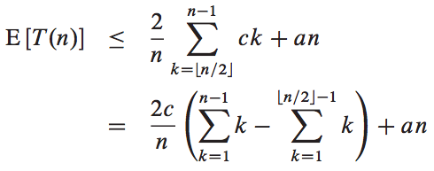
Selection in Expected Linear Time

Slide 15
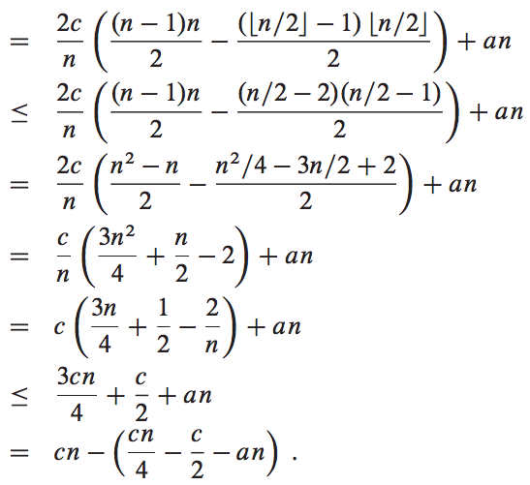


Selection in Expected Linear Time

Slide 16

Selection in Expected Linear Time

Slide 17
Selection in Worst-Case Linear Time
SELECT: a selection algorithm whose running time is O(n) in the worst case
SELECT finds the desired element by recursively partitioning the input array
We guarantee a good split upon partitioning the array
SELECT uses a modified version of the deterministic partitioning algorithm PARTITION from quicksort

Slide 18


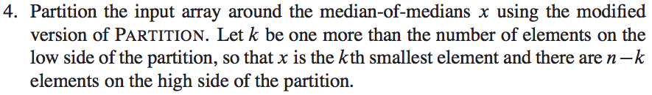
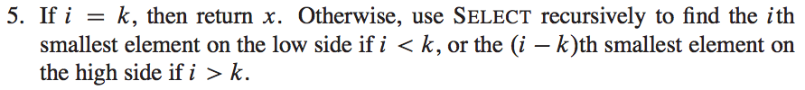
Selection in Worst-Case Linear Time
If n=1, then SELECT merely returns its only input value as the i^{th} smallest. Otherwise

Slide 19

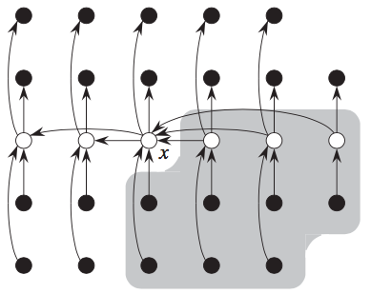
Selection in Worst-Case Linear Time
We first determine a lower bound on the number of elements that are greater than the partitioning element x
At least half of the medians found in step 2 are greater than or equal to the median-of-medians x
At least half of the groups contribute at least 3 elements that are greater than x
except for the one group that has fewer than 5 elements if 5 does not divide n exactly, and the one group containing x itself
Discounting these two groups, it follows that the number of elements greater than x is at least
Similarly, at least 3n/10 -6 elements are less than x. Thus, in the worst case, step 5 calls SELECT recursively on at most 7n/10 + ^{6 elements.}

Slide 20


Selection in Worst-Case Linear Time
If n=1, then SELECT merely returns its only input value as the i^{th} smallest. Otherwise

Slide 21


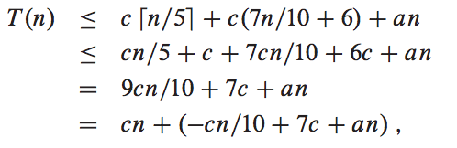
Selection in Worst-Case Linear Time

Slide 22


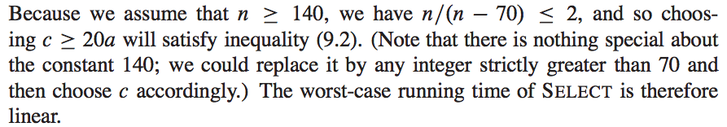
Selection in Worst-Case Linear Time

Slide 23
Selection vs Sorting
As in a comparison sort (see Section 8.1), SELECT and RANDOMIZED-SELECT determine information about the relative order of elements only by comparing elements
Sorting requires Ω(n lg n) time in the comparison model, even on average
The linear-time sorting algorithms in Chapter 8 make assumptions about the input
In contrast, the linear-time selection algorithms in this chapter do not require any assumptions about the input
They are not subject to the Ω(n lg n) lower bound because they manage to solve the selection problem without sorting

